Slide 1














Interactive Census Analysis of India
project

Slide 2

A Visual Analysis" project is to provide an in-depth and interactive exploration of India's census data. By leveraging various visualizations and key performance indicators (KPIs), the project aims to present insights into the population distribution, growth trends, literacy rates, and gender demographics across states and districts. The goal is to enable users to understand and analyze demographic patterns, identify correlations, and make data-driven decisions based on the visual representation of complex data.
objective of the project

Slide 3
introduction
A Visual Analysis" project is designed to offer a comprehensive and interactive exploration of India's census data, highlighting key demographic trends and patterns.
Utilizing a range of visualizations, including bar charts, line graphs, pie charts, and scatter plots, this project provides insights into population distribution, growth rates, literacy levels, and gender ratios across various states and districts in India.
Through the use of slicers and KPIs, users can easily navigate and filter the data, making it an accessible tool for analyzing the complex demographic landscape of the country.
The project serves as a valuable resource for researchers, policymakers, and anyone interested in understanding India's evolving demographic profile.

Slide 4
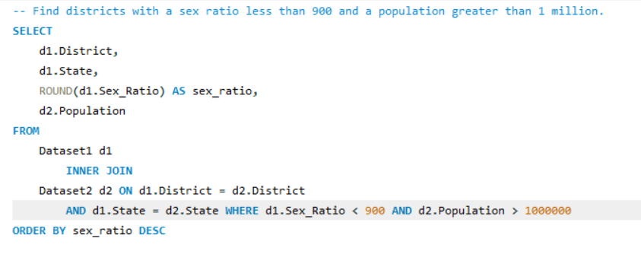
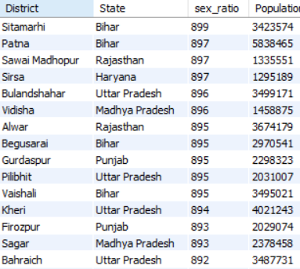

Slide 5
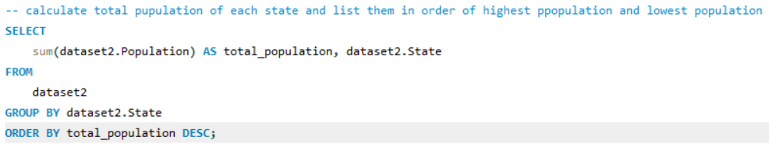
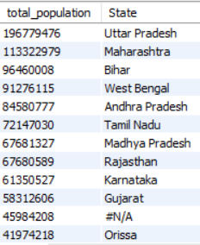

Slide 6
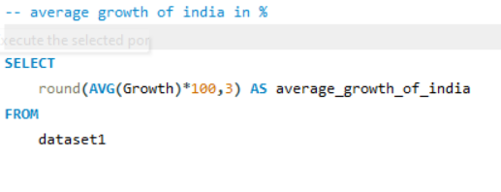


Slide 7
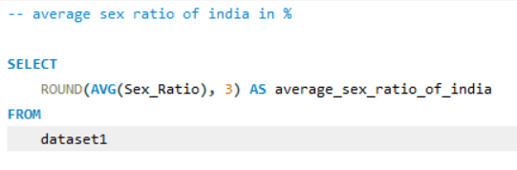


Slide 8
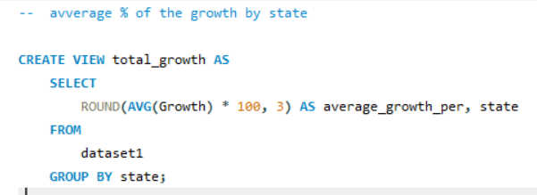
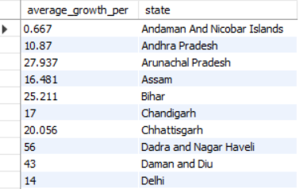

Slide 9
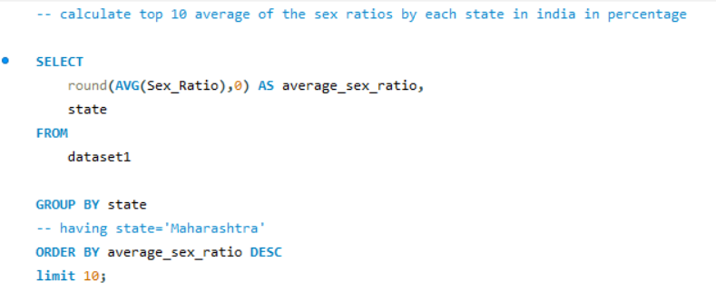
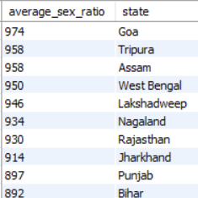

Slide 10
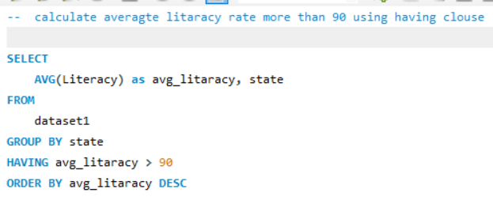


Slide 11
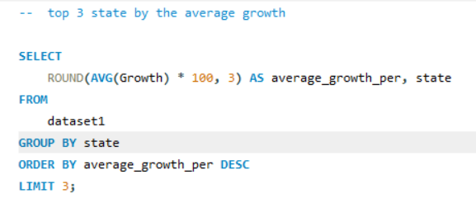
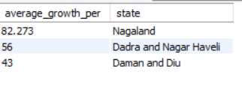

Slide 12
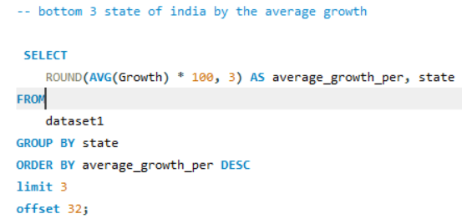
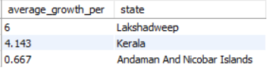

Slide 13
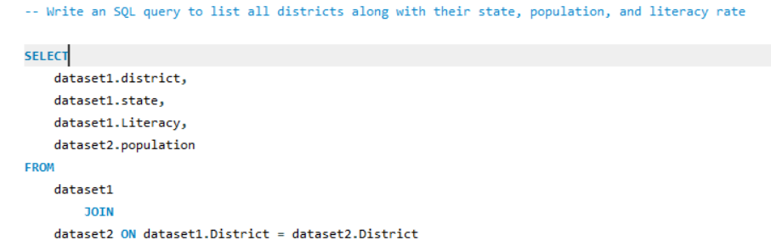
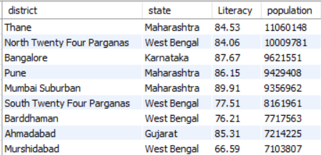

Slide 14
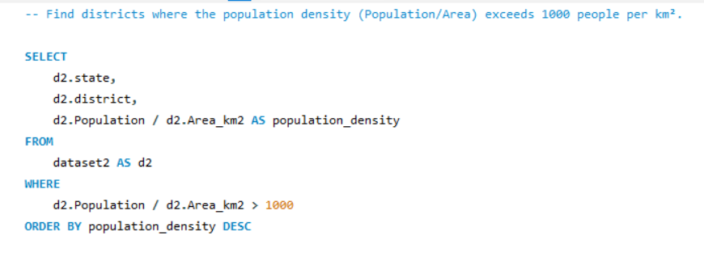
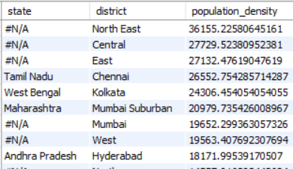

Slide 15
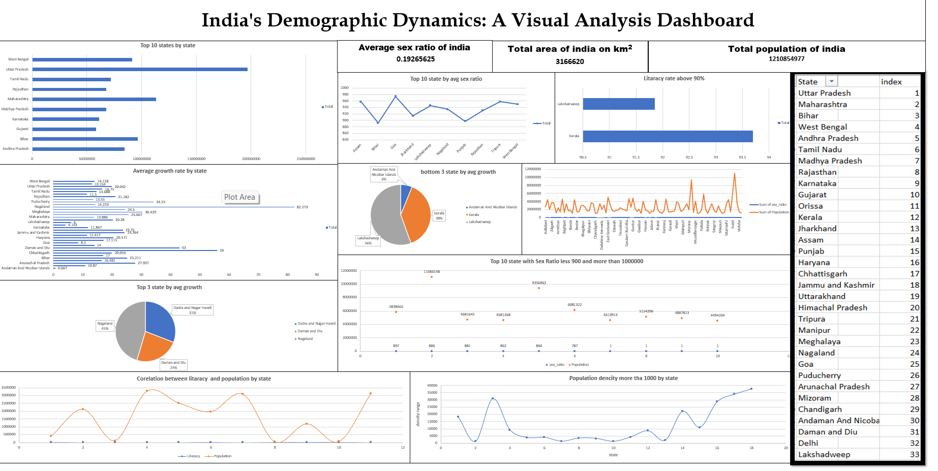

Slide 16
insights
7. Top 10 States with Sex Ratio Less than 900 and Population Greater than 1 Million (Bubble Chart)
Insight: The bubble chart identifies states where the sex ratio is less than 900 and the population exceeds 1 million. This highlights regions with gender imbalances in larger populations, such as Haryana and Punjab.
1. Top 10 States by Population (Bar Chart)
Insight: The bar chart shows the top 10 states in India by population. Uttar Pradesh and Maharashtra have the largest populations, highlighting their significance in the overall demographic structure of the country.
3. Top 10 States by Average Sex Ratio (Line Chart)
Insight: The line chart illustrates the average sex ratio across the top 10 states. It shows variations in the sex ratio, with some states like Kerala maintaining a higher balance between males and females, while others like Haryana have lower ratios.
5. Bottom 3 States by Average Growth (Pie Chart)
Insight: This chart shows the bottom 3 states by average growth rate. States like Lakshadweep, Kerala, and Andaman and Nicobar Islands have slower population growth, indicating more stable population sizes
2. Average Growth Rate by State (Bar Chart)
Insight: This chart displays the average growth rate across different states. States like Dadra and Nagar Haveli show a significantly higher growth rate compared to others, indicating rapid population increases in these regions.
6. Literacy Rate Above 90% (Pie Chart)
Insight: This pie chart indicates the states where the literacy rate is above 90%. Kerala stands out as the state with the highest literacy rate, reinforcing its reputation for educational achievement.
8. Correlation Between Literacy and Population by State (Line Chart)
Insight: The line chart explores the correlation between literacy rates and population size. There is no direct correlation, as some states with higher populations do not necessarily have higher literacy rates and vice versa.
4. Top 3 States by Average Growth (Pie Chart)
Insight: The pie chart highlights the top 3 states with the highest average growth rates. Nagaland, Dadra and Nagar Haveli, and Daman and Diu are leading, indicating where population growth is most concentrated.
9. Population Density More than 1000 People per km² by State (Scatter Plot)
Insight: The scatter plot shows the states where population density exceeds 1000 people per km². This indicates highly populated areas, with states like Bihar and West Bengal being densely populated.

Slide 17



thank you

